Slide 1


Introduction to Cybersecurity
Network Security
ILIA STATE UNIVERSITY
Paata Gogishvili
Doctor of Informatics
Associate Professor
School of Technology
October 23, 2024
Faculty of Business, Technology and Education

Slide 2
Lecture Topics
Information Exchange via Network
Connecting to The Protected Network
Attack the WiFi Network (Theory)
Installing External USB Adapters (WiFi Antenna)
Attack the Network Devices
WPA and WPA2 Password Brutforce
ILIA STATE UNIVERSITY

Slide 3
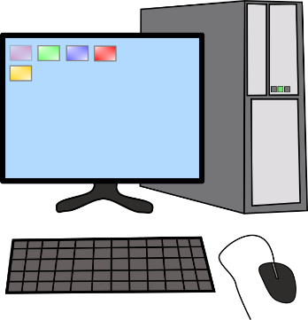
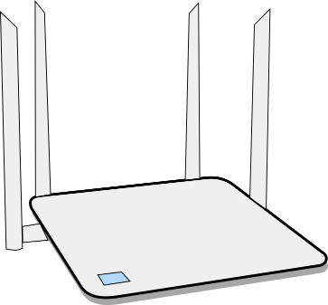

Information Exchange via Network
ILIA STATE UNIVERSITY

Slide 4
Every Device Has The Mac Address
0a-13-5b-fe-c1-b4
ILIA STATE UNIVERSITY
00-06-31-db-b0-a8
0c-96-e6-04-05-f7

Slide 5
Router Sets Local IP Address
0a-13-5b-fe-c1-b4
ILIA STATE UNIVERSITY
00-06-31-db-b0-a8
192.168.2.1
0c-96-e6-04-05-f7

Slide 6
Router Assigns Local IP Adresses
192.168.2.25
0a-13-5b-fe-c1-b4
ILIA STATE UNIVERSITY
00-06-31-db-b0-a8
192.168.2.1
192.168.2.1
0c-96-e6-04-05-f7

Slide 7
Every Device Gets Local IP Address
0a-13-5b-fe-c1-b4
192.168.2.25
ILIA STATE UNIVERSITY
00-06-31-db-b0-a8
192.168.2.1
0c-96-e6-04-05-f7
192.168.2.1

Slide 8
ARP is Address Resolution Protocol
Try arp -a command.
0a-13-5b-fe-c1-b4
192.168.2.25
ILIA STATE UNIVERSITY
00-06-31-db-b0-a8
192.168.2.1
0c-96-e6-04-05-f7
192.168.2.26

Slide 9

Laptop Initiates Connection to Facebook
0a-13-5b-fe-c1-b4
192.168.2.25
ILIA STATE UNIVERSITY
facebook.com
00-06-31-db-b0-a8
185.60.218.35
192.168.2.1
0c-96-e6-04-05-f7
192.168.2.26

Slide 10
Router Forwards the Request
0a-13-5b-fe-c1-b4
192.168.2.25
ILIA STATE UNIVERSITY
facebook.com
00-06-31-db-b0-a8
185.60.218.35
192.168.2.1
0c-96-e6-04-05-f7
192.168.2.26

Slide 11
Facebook Process The Request
0a-13-5b-fe-c1-b4
192.168.2.25
ILIA STATE UNIVERSITY
facebook.com
00-06-31-db-b0-a8
185.60.218.35
192.168.2.1
0c-96-e6-04-05-f7
192.168.2.26

Slide 12
Facebook Replies to The Request
0a-13-5b-fe-c1-b4
192.168.2.25
ILIA STATE UNIVERSITY
facebook.com
00-06-31-db-b0-a8
185.60.218.35
192.168.2.1
0c-96-e6-04-05-f7
192.168.2.26

Slide 13
Router Asks for IP Address
?
192.168.2.26
0a-13-5b-fe-c1-b4
192.168.2.25
ILIA STATE UNIVERSITY
facebook.com
00-06-31-db-b0-a8
185.60.218.35
192.168.2.1
0c-96-e6-04-05-f7
192.168.2.26

Slide 14
Laptop Responds to Router
?
192.168.2.26
0a-13-5b-fe-c1-b4
192.168.2.25
ILIA STATE UNIVERSITY
facebook.com
00-06-31-db-b0-a8
185.60.218.35
192.168.2.1
0c-96-e6-04-05-f7
192.168.2.26

Slide 15
Laptop Gets The Answer From Facebook
0a-13-5b-fe-c1-b4
192.168.2.25
ILIA STATE UNIVERSITY
facebook.com
00-06-31-db-b0-a8
185.60.218.35
192.168.2.1
0c-96-e6-04-05-f7
192.168.2.26

Slide 16
Another Computer Can Respond to Router
0a-13-5b-fe-c1-b4
192.168.2.1
ILIA STATE UNIVERSITY
facebook.com
00-06-31-db-b0-a8
185.60.218.35
192.168.2.1

Slide 17
The IP Address and MAC Should Match
0a-13-5b-fe-c1-b4
192.168.2.26
ILIA STATE UNIVERSITY
facebook.com
00-06-31-db-b0-a8
185.60.218.35
192.168.2.1

Slide 18
Most WiFi Networks Are Protected
ILIA STATE UNIVERSITY
WPA, WPA2

Slide 19

Handshake Is Mandatory For Access
ILIA STATE UNIVERSITY
WPA, WPA2

Slide 20

Hackers Intercept Handshake Packets
ILIA STATE UNIVERSITY
WPA, WPA2

Slide 21
Password Can Be Extracted from Handshake Packet
password
ILIA STATE UNIVERSITY

Slide 22

Locate Target Access Point
ILIA STATE UNIVERSITY

Slide 23


Locate Target Access Point
Luka777
ILIA STATE UNIVERSITY

Slide 24


Locate Target Access Point
Ahmed
Luka777
ILIA STATE UNIVERSITY

Slide 25

Locate Target Access Point
Ahmed
Luka777
Home
ILIA STATE UNIVERSITY

Slide 26


Locate Target Access Point
Maia
Ahmed
Luka777
Home
ILIA STATE UNIVERSITY

Slide 27
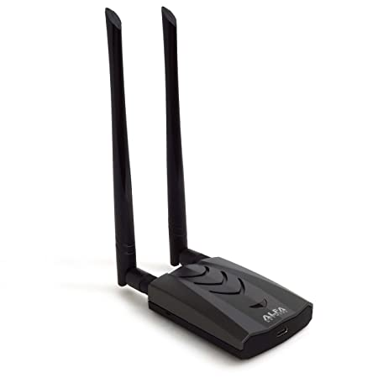
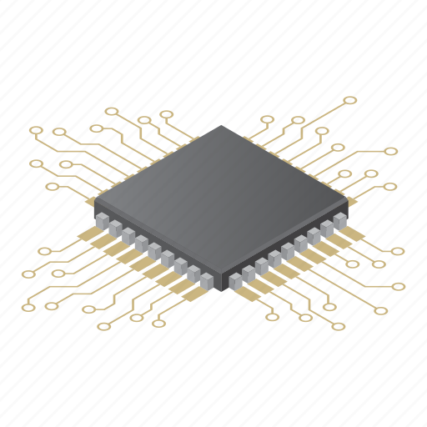
WiFi Chipset With Monitoring Mode
ILIA STATE UNIVERSITY
RTL8812AU
ALFA
AWUS036ACH

Slide 28
Most Built-in Chipsets Does Not Support
ILIA STATE UNIVERSITY
RTL8812AU
ALFA
AWUS036ACH
Chipset with monitoring mode

